Slide 1
Introduction to Machine Learning capstone project
Bence Magyar
Sept 18^{th,} 2018 Cohort

Slide 2
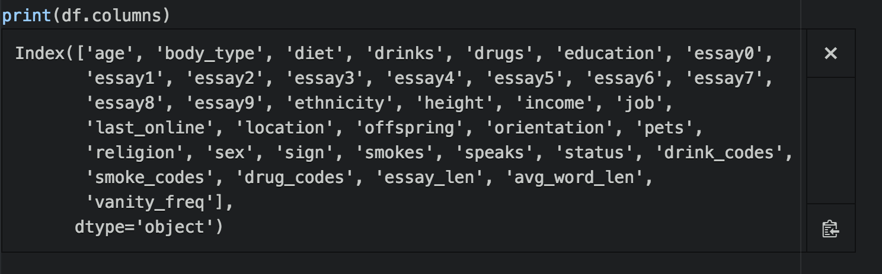
Read dataset and explore columns

Slide 3
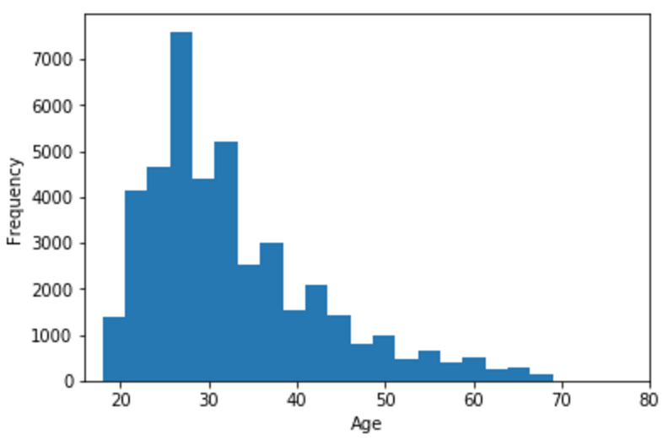
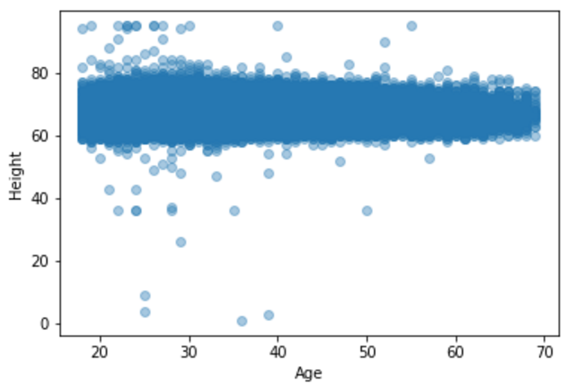
Data exploration: plots

Slide 4
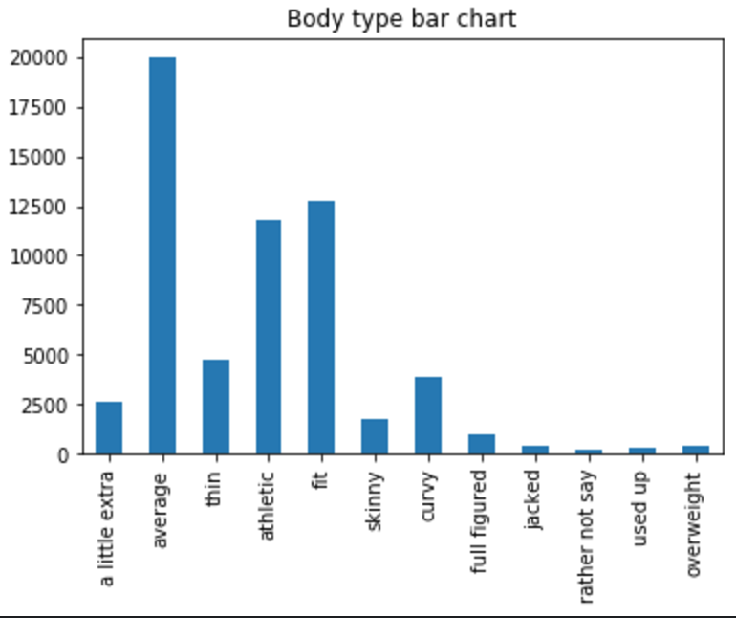
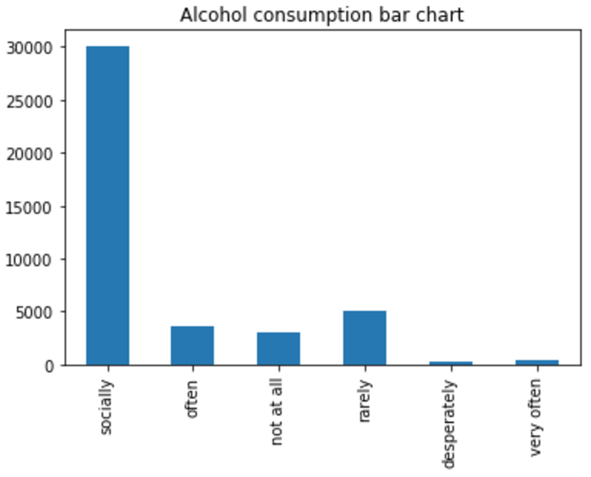
Data exploration: plots
Let’s look at the distribution of body types. Let’s look at the distribution of alcohol consumption

Slide 5
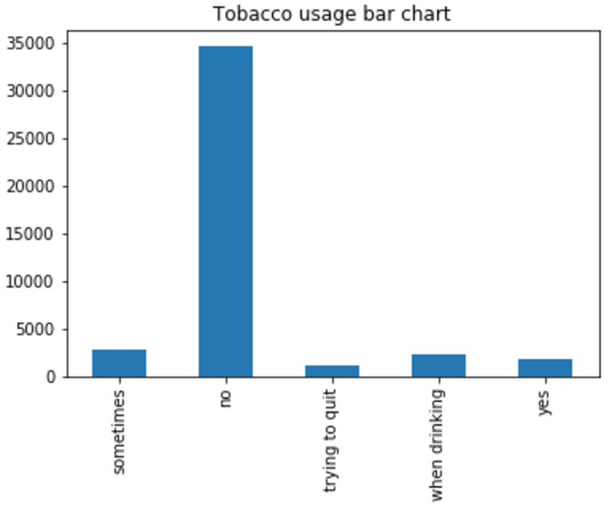
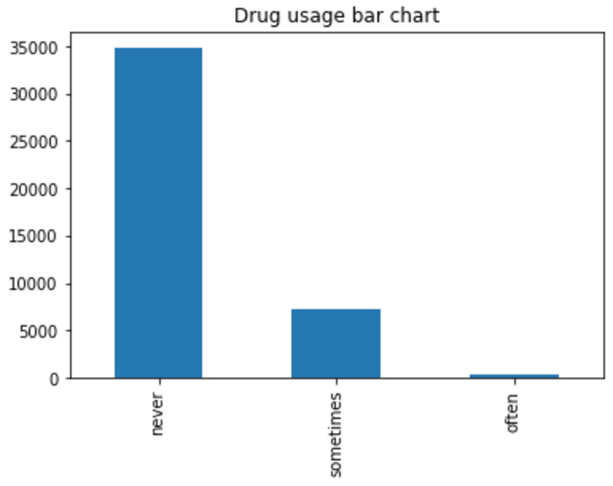
Data exploration: plots
Let’s look at the distribution of tobacco usage. Let’s look at the distribution of drug use

Slide 6
My question
Can we use machine learning to predict a person’s overall biometric / health information based on their lifestyle factors?
The dataset includes lots of “lifestyle” information, including:
Diet, smoke usage, alcohol usage, drug usage
Let’s work with the above features - plus some others
We will use classification to classify a discrete label (body_type)
We will use regression techniques to predict a continuous label (height)

Slide 7
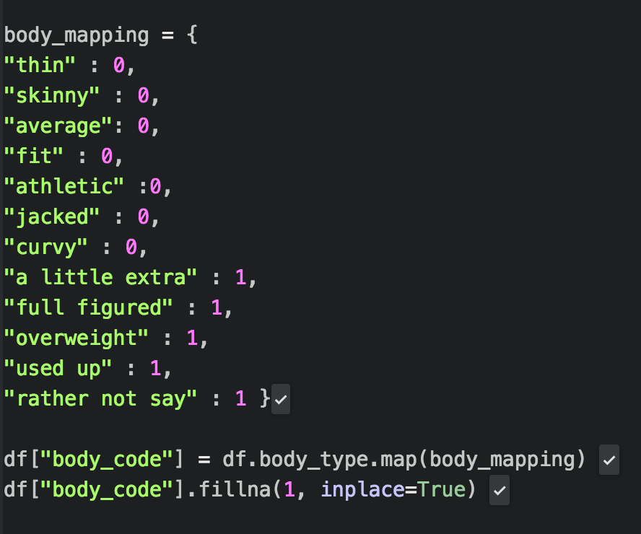
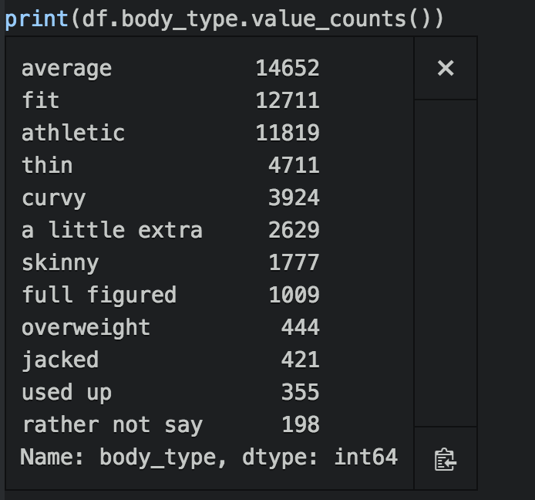
Added BODY Type COLUMN
In addition to the smoke, drug, and drink code columns already added in the exercise, I also mapped our target label, (body_type) to a set of codes. For simplicity, I've filtered similar body types into 2 discrete class labels:
0, to denote a “healthy” / positive view of physique
1, to denote an ”unhealthy / negative view of physique
Map values, add column

Slide 8
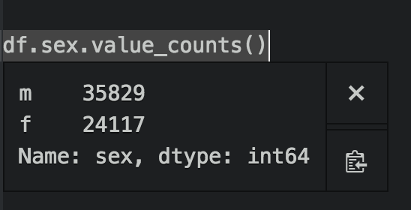
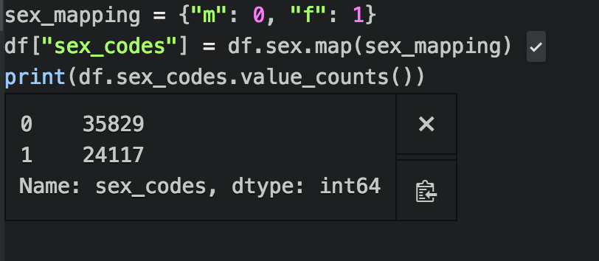
added sex code column
In addition to mapping the target body type to a set of discrete codes in {0,1}, I was also interested in whether sex (male/female) played a role in classifying body type. Do men and women view (or self-report) their physique differently? What about age?
Map values, add column

Slide 9
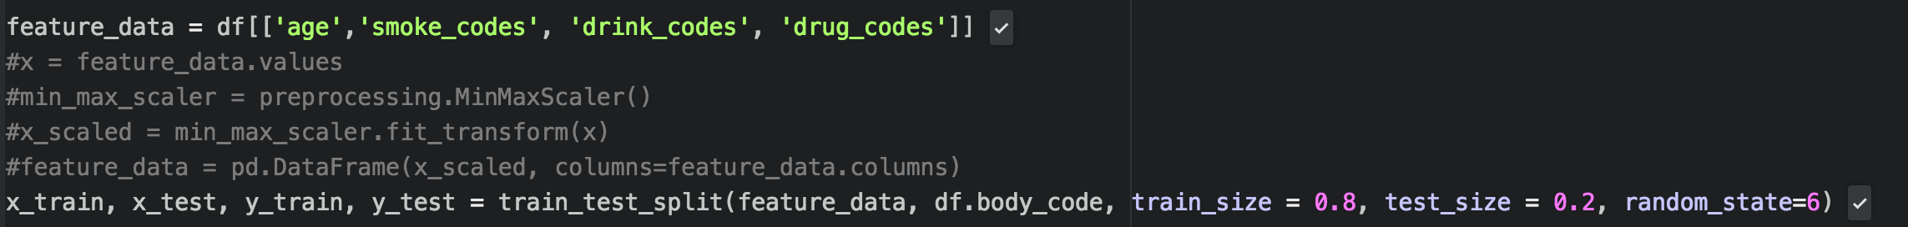
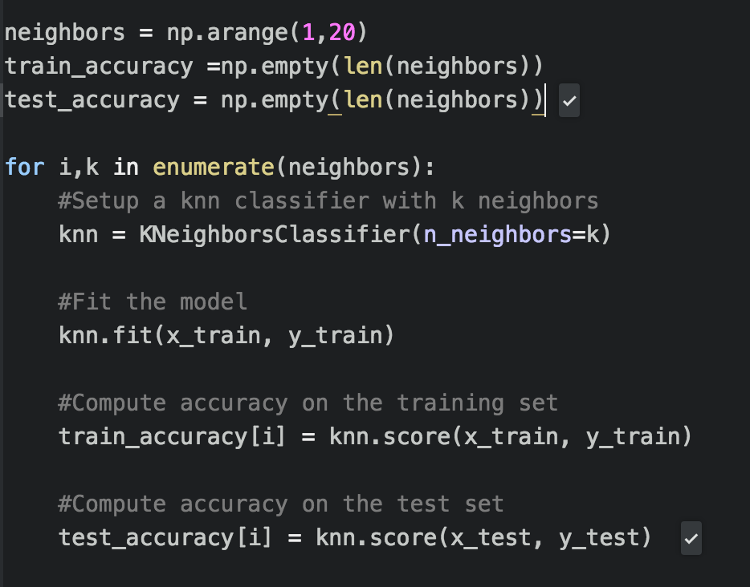
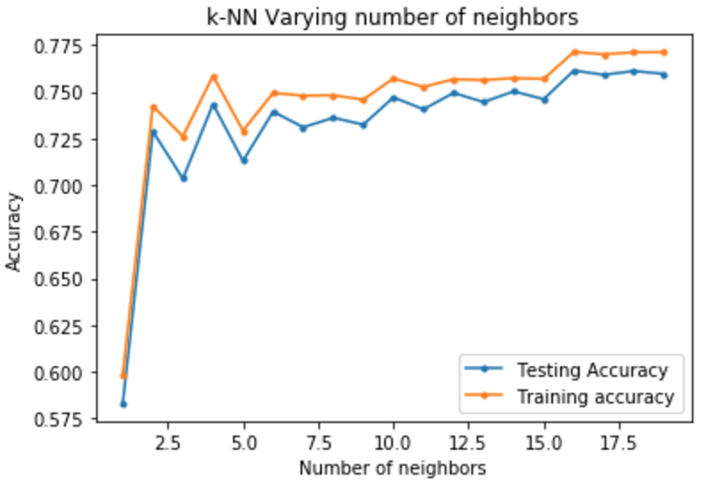
Classification technique 1: KNN
Plot scores for KNN

Slide 10
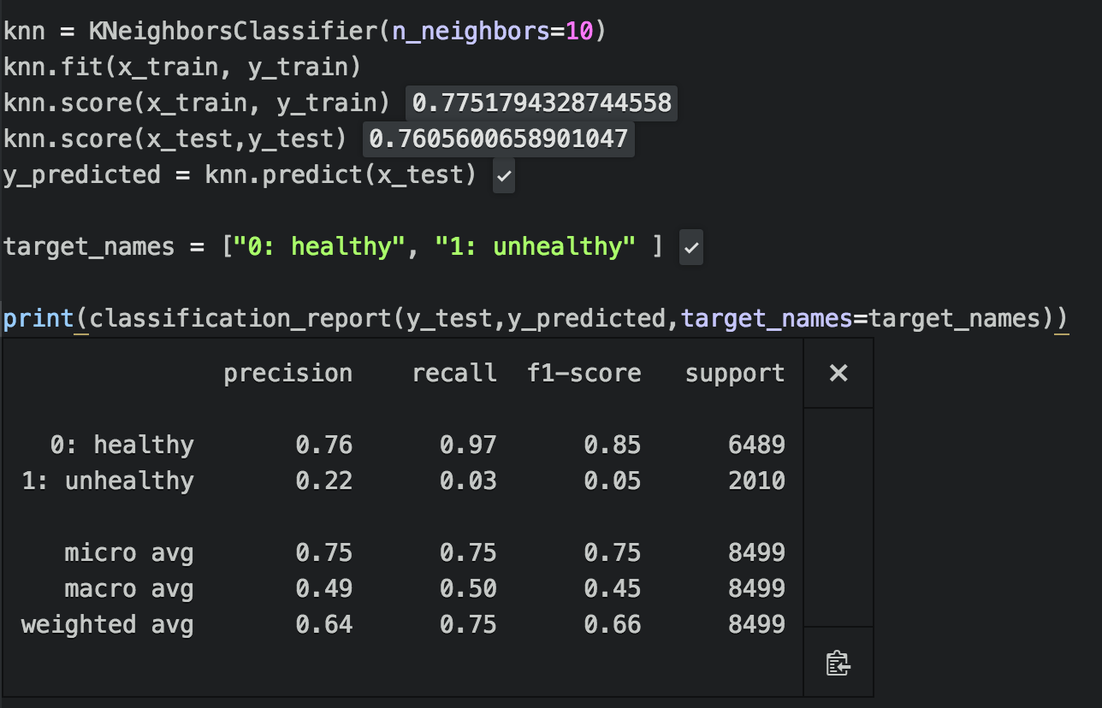
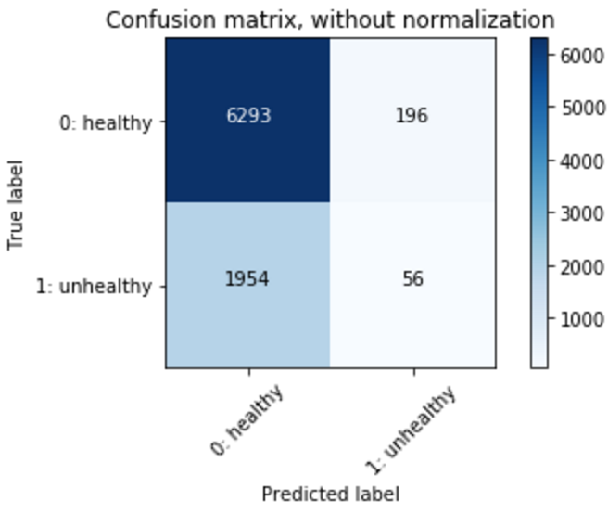
Run KNN using k=10: classification report

Slide 11
Run KNN using k=10: comments
Precision = tp / (tp + fp) .
Precision is the percentage of true positives from all positive classifications
For our healthy body type class 0, the classifier had excellent precision.
For our unhealthy body type class 1, the classifier had low precision, with 78% of the class 1 classifications being false positives
Recall = tp / (tp + fn)
Recall is the percentage of true positives that were returned.
For our healthy body type (class 0), the classifier had excellent recall.
For our unhealthy body type, (class 1), the classifier had very low recall.
My hypothesis is that this is due to the relative low number of samples with target label = 1 in the training data. The majority of OkCupid users rated their body type as ”average” (14,652), ”fit” (12,711) or “athletic” (11,819).
Clearly, there is a class imbalance problem here.

Slide 12
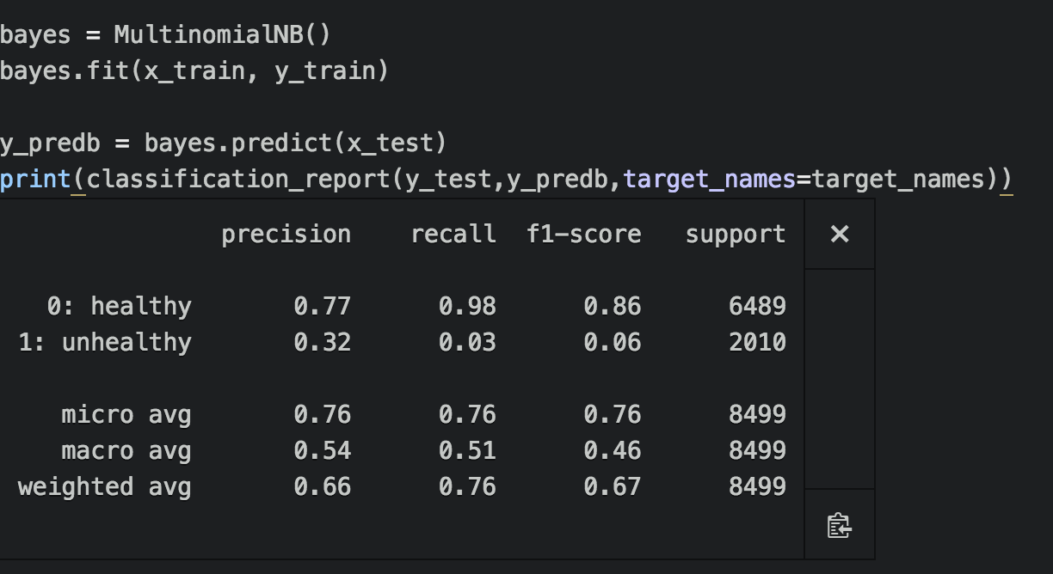
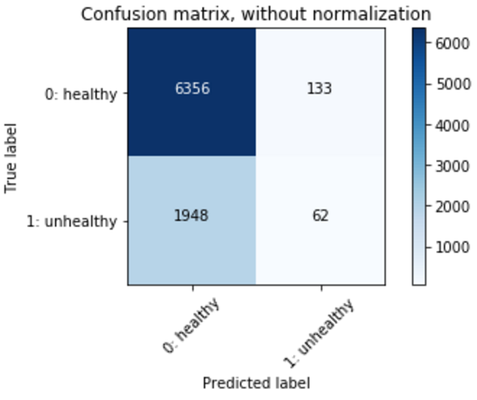
Classification technique 2: Naïve Bayes
The class imbalance problem is confirmed here, too!

Slide 13
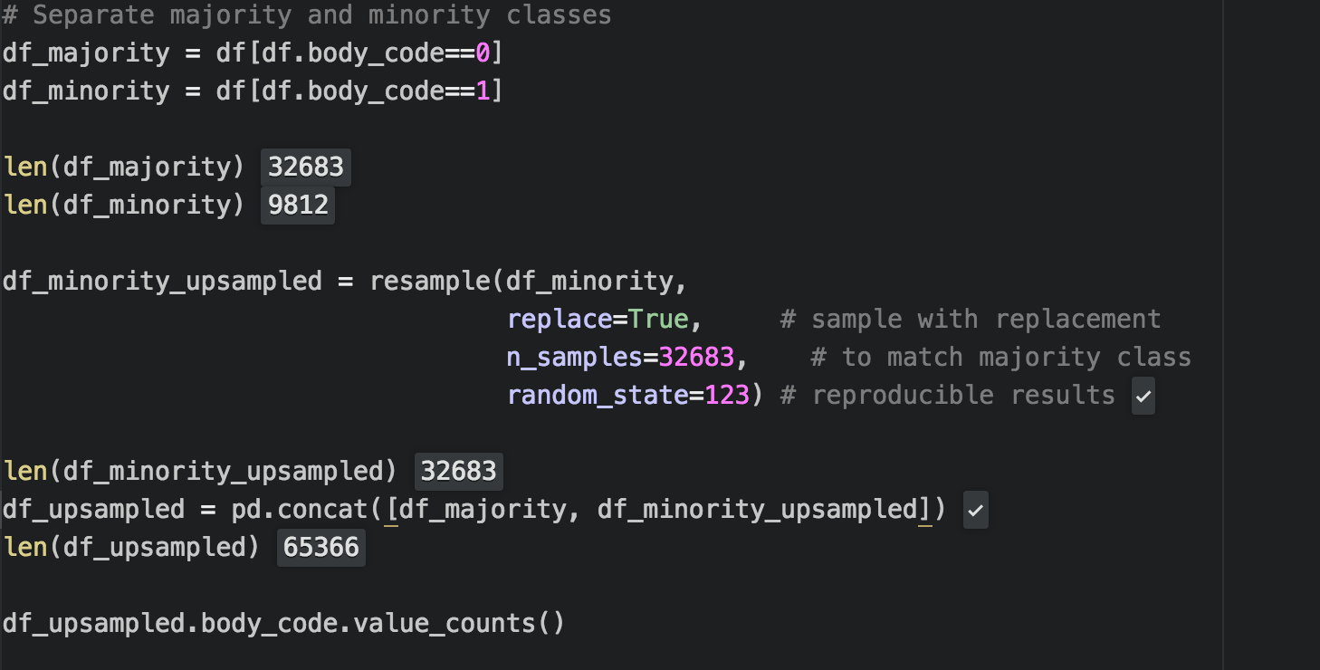
Let’s fix the class imbalance problem…
First I tried using a RandomForestClassifier. I did some research online, which stated that tree-based classifiers were better at handling imbalanced classes.
Unfortunately, this didn’t solve my issue – the RandomForestClassifier still returned low precision and recall for target class 1.
So….what can we do? Let’s upsample the minority class!
Let’s balance the classes so we have a 1:1 ratio:

Slide 14
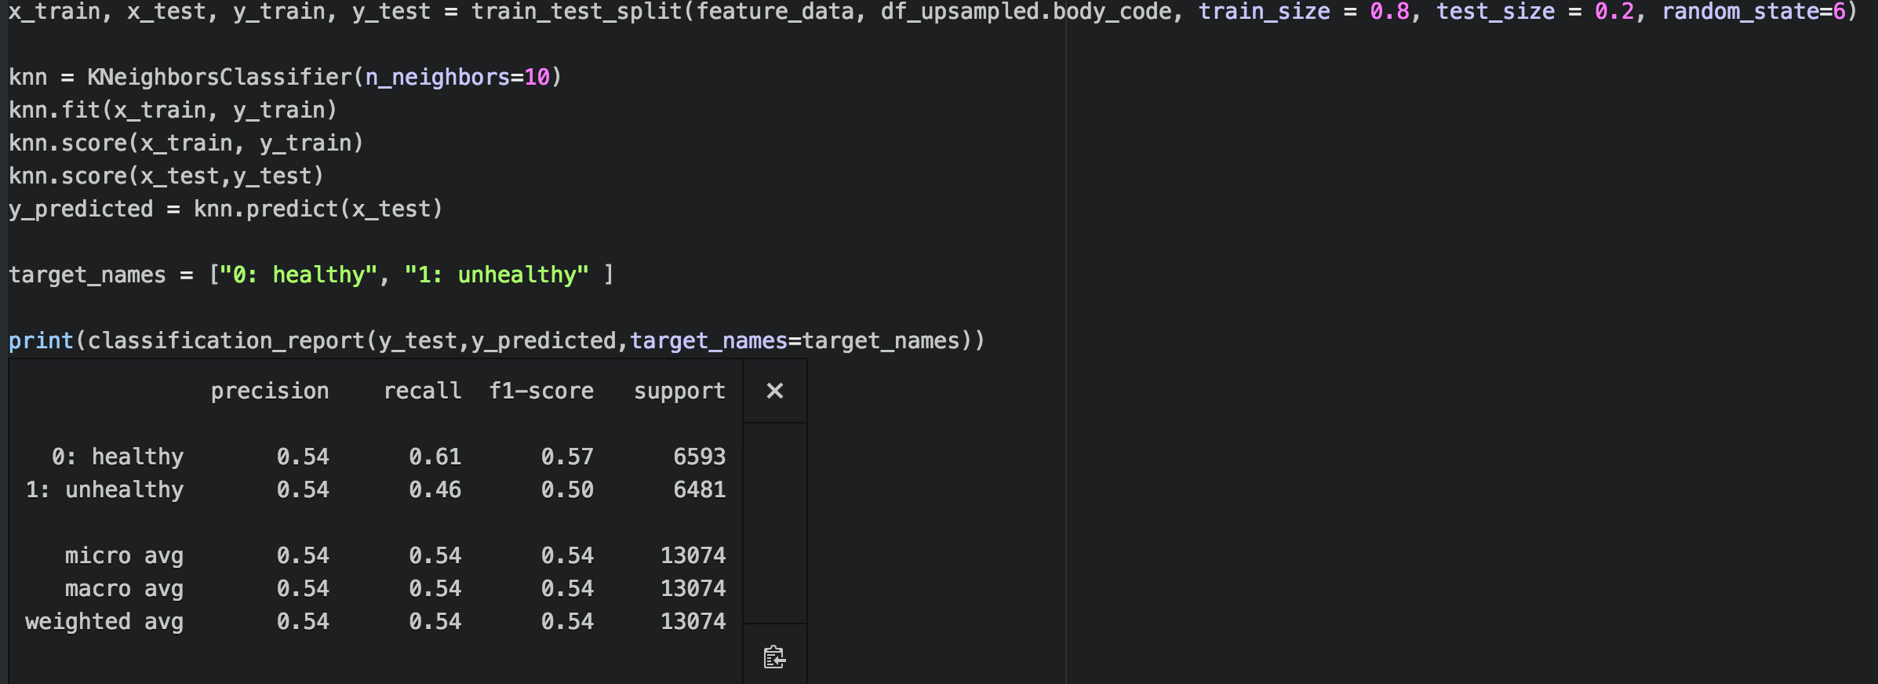
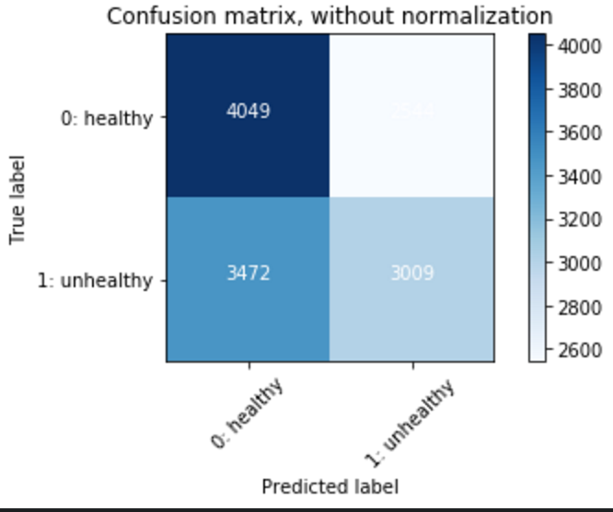
After upsampling the minority class…
Much better balance!

Slide 15
What we’ve uncovered so far…
We’ve discovered that we can classify a person’s body type using lifestyle factors: tobacco, alcohol, and drug usage, as well as their age.
However, precision and recall scores are very low for the second target label.
A technique of upsampling the minority class vastly improved the problem.
Next, lets try to make a prediction using regression!
We will use regression techniques to predict a continuous label (height)

Slide 16
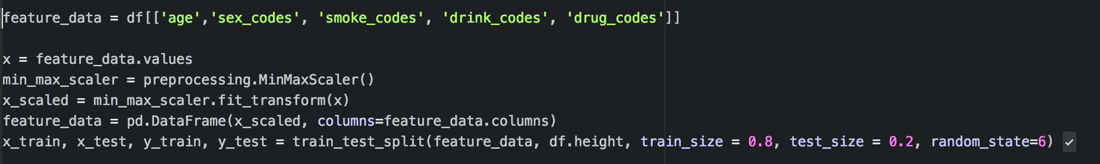
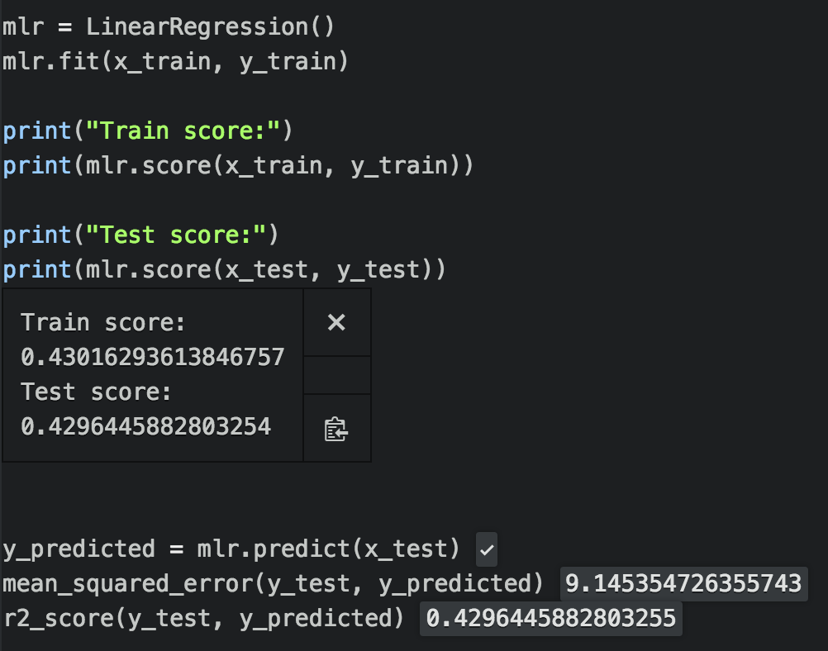
Regression technique 1: Linear regression
Training score = 0.43
Test score = 0.42
Mean squared error regression loss = 9.14
R² score = 0.42
Not great! But at least we can use this data as a baseline!

Slide 17
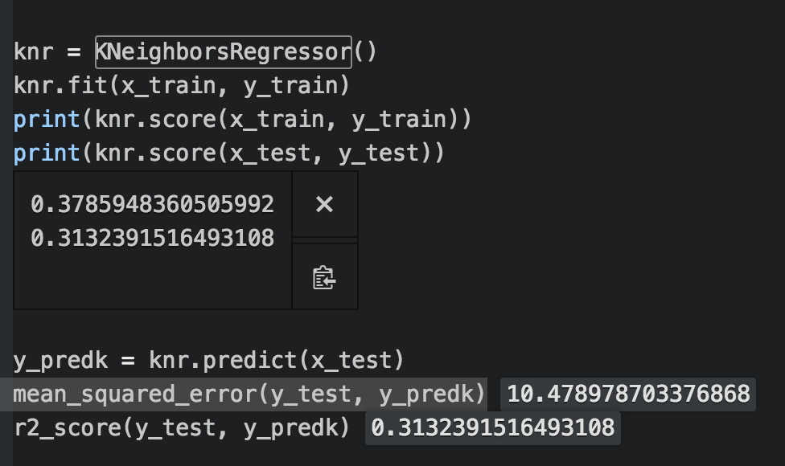
Regression technique 2: KNN regression
Training score = 0.38
Test score = 0.31
Mean squared error regression loss = 10.47
R² score = 0.31
Ok, seems like the linear regression worked slightly better!

Slide 18
conclusions
The KNN and SVC classifiers did a decent job of making a binary classification of the overall body-type / physique of the users based on lifestyle: tobacco, alcohol, and drug use. Upsampling the minority class improved the class imbalance problem.
The regression models (linear, KNN) were not able to predict a users height very well. This is likely due to the fact that a persons height has low overall correlation to the lifestyle choices made in adulthood. The feature with the highest coefficient was the “sex code”. This make sense, as males tend to be taller than females.
It would have been great to have data around weight. (Probably would be weird to ask that on dating website) We could have done some feature engineering to add a body mass index (BMI) feature. Tobacco and alcohol use are both linked to higher BMI.
Final notes: I also experimented with a large variety of other questions that I hoped would lead to higher levels of correlation. For example, I tried predicting income based on education level. I also tried predicting essay length based on education level. I tried predicting age based on education level. I spent a lot of time cleaning the education and income features to remove outliers. Unfortunately, all of these experiments left me with very low training/testing accuracy scores. I ultimately decided to stay with prediction of user height.
Thanks for a great course! I learned a lot!

